Slide 1
Becoming a CDCES®: The Short and Sweet of It
®
Ambassador Presentation
(last updated Sept 2024)
Notes:
This presentation is being provided as an overview regarding the Certification Board for Diabetes Care and Education (CBDCE) and the CDCES certification program.
The individual providing this information may or may not be a CDCES and/or a CBDCE Board or staff member.
It is important that you refer to the current Examination Handbook or the CBDCE website for any clarifications on eligibility requirements or the examination application/administration process.
Regardless of the information presented here, CBDCE is the certifying body that oversees and makes the final decisions regarding all aspects of the CDCES certification program.
Presentation prepared 9/2024; updates to eligibility, application and administration processes may occur.

Slide 2
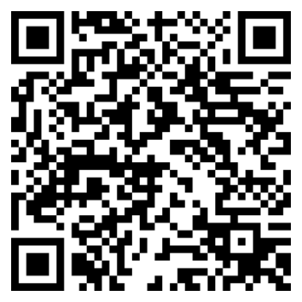
Today’s Presenter:
Name & Credentials, CDCES
Contact Information: Email Address
Scan for access to the presentation survey
Notes:
Introduce yourself and alert the participants to the presentation survey (will show the survey access info again at the end)

Slide 3
National Certification Board for Diabetes Educators
Certification Board for Diabetes Care and Education
1986
2020
Certified Diabetes Educator
Certified Diabetes Care and Education Specialist®
®
®
Notes:
In 2020, both the name of the organization and credential was changed.

Slide 4
Fast Facts about Diabetes
Diabetes
Total: 38.4 million people have diabetes (11.6% of the US population)
Diagnosed: 29.7 million people, including 29.4 million adults
Undiagnosed: 8.7 million people (22.8% of adults are undiagnosed)
Prediabetes
Total: 97.6 million people aged 18 years or older have prediabetes (38.0% of the adult US population)
65 years or older: 27.2 million people aged 65 years or older (48.8%) have prediabetes
Centers for Disease Control and Prevention. National Diabetes Statistics Report website. https://www.cdc.gov/diabetes/php/data-research/?CDC_AAref_Val=https://www.cdc.gov/diabetes/data/statistics-report/ . Accessed 6/12/2024.
Notes:
Continuing increase in the prevalence of diabetes and the need for more health professionals specializing in diabetes. This does not include global OUS (Outside the US). Other countries are also seeing exponential growth in diabetes prevalence.

Slide 5
Diagnosed Diabetes, Total, Adults Aged 18+ Years, Age-Adjusted Percentage, U.S. States
2021
2006
2016
Percentage ( Natural Breaks )
4.3 - 6.5
6.6 - 7.7
7.8 - 8.9
9 - 10.8
10.9 - 16.6
No Data
Suppressed
Source:
USDSS
Disclaimer: This is a user-generated report. The findings and conclusions are those of the user and do not necessarily represent the views of the CDC.
Notes:
Visual representation of increase of diabetes

Slide 6
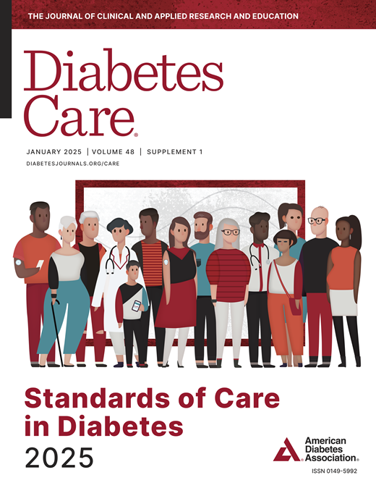
Diabetes Self-Management Education Support (DSMES): Component of Standard Diabetes Care
“… Ongoing patient self-management education and support are critical to empowering people, preventing acute complications and reducing the risk of long-term complications …” ¹
You may also know diabetes education as ‘diabetes self-management education and support’ or ‘DSMES’
ADA. Standards of Care in Diabetes. Diabetes Care (2025), 48 (Supplement 1): S1 & Joint Position Statement on DSMES. 2020
Notes:
Main point of this slide
Diabetes Self Management education and support (aka DSMES or diabetes education) is a component of standard diabetes care. Referrals for DSMES are recommended for quality diabetes care.
FYI Notes:
Updated annually, the American Diabetes Association’s Standards of Medical Care in Diabetes provides clinicians and others with the components of diabetes care, general treatment goals and tools to evaluate the quality of care. It is published every January as a supplement to Diabetes Care. ADA provides complimentary access.
The introduction to the 2025 Standards of Care begins: “Diabetes is a complex, chronic illness requiring continuous medical care with multifactorial risk-reduction strategies beyond glycemic control. Ongoing patient self-management education and support are critical to preventing acute complications and reducing the risk of long-term complications. Significant evidence exists that supports a range of intervention to improve diabetes outcomes…”
Seven national health organizations have published a position statement to define when DSMES should be provided for type 2 diabetes and what is included at each of the time points for quality diabetes care. Many of the recommendations are appropriate for other types of diabetes. The 7 organizations are the American Diabetes Association, the Association of Diabetes Care & Education Specialists, the Academy of Nutrition and Dietetics, the American Academy of Family Physicians, the American Academy of PAs, the American Association of Nurse Practitioners, and the American Pharmacists Association. Additionally, the Certification Board for Diabetes Care and Education (CBDCE) supports the position statement and its implementation.
The Joint Position Statement notes the 4 critical times as: (1) at diagnosis; (2) during the annual assessment; (3) when new complicating factors occur; and (4) when transitions occur
The Joint Position Statement on DSMES includes an algorithm that describes specifics of when and what DSMES should be provided; thus helping to clarify and guide referral for DSMES. It includes a checklist of when to refer and a checklist of needed education and support for clinical, psychosocial, and behavioral aspects of diabetes care. The algorithm can be reproduced as a stand alone document as an easily available resource.
Resources
ADA Standards of Medical Care in Diabetes. Diabetes Care (2025): https://diabetesjournals.org/care/issue/48/Supplement_1

Slide 7
DSMES
Share the information: Joint Position Statement on DSMES
Diabetes Self-Management Education and Support in Adults With Type 2 Diabetes: A Consensus Report of the American Diabetes Association, the Association of Diabetes Care & Education Specialists, the Academy of Nutrition and Dietetics, the American Academy of Family Physicians, the American Academy of PAs, the American Association of Nurse Practitioners, and the American Pharmacists Association
Published originally 2015; updated 2020
Joint Position Statement on DSMES. 2020: https://doi.org/10.2337/dci20-0023
Notes:
Seven national health organizations have published a position statement to define when DSMES should be provided for type 2 diabetes and what is included at each of the time points for quality diabetes care. Many of the recommendations are appropriate for other types of diabetes. The 7 organizations are the American Diabetes Association, the Association of Diabetes Care & Education Specialists, the Academy of Nutrition and Dietetics, the American Academy of Family Physicians, the American Academy of PAs, the American Association of Nurse Practitioners, and the American Pharmacists Association. Additionally, the Certification Board for Diabetes Care and Education (CBDCE) supports the position statement and its implementation.
The Joint Position Statement notes the 4 critical times as: (1) at diagnosis; (2) during the annual assessment; (3) when new complicating factors occur; and (4) when transitions occur
The Joint Position Statement on DSMES includes an algorithm that describes specifics of when and what DSMES should be provided; thus helping to clarify and guide referral for DSMES. It includes a checklist of when to refer and a checklist of needed education and support for clinical, psychosocial, and behavioral aspects of diabetes care. The algorithm can be reproduced as a stand alone document as an easily available resource.

Slide 8
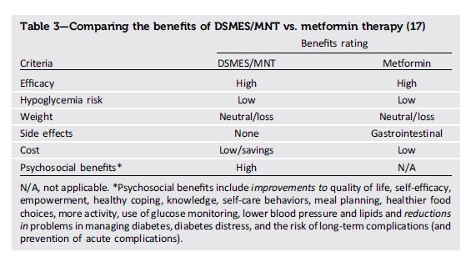
DSMES
https://diabetesjournals.org/care/article/43/7/1636/35565/Diabetes-Self-management-Education-and-Support-in or https://doi.org/10.2337/dci20-0023
Notes:
Benefits of DSMES participation can include:¹
Improved hemoglobin A1c levels
Improved control of blood pressure and cholesterol levels
Higher rates of medication adherence
Fewer or less severe diabetes-related complications
Healthier lifestyle behaviors, such as improved or healthier nutrition, increased physical activity, and use of primary care and preventive services
Enhanced self-efficacy
Decreased health care costs, including fewer hospital admissions and readmissions

Slide 9
Becoming a CDCES
Notes:
A CDCES serves trusted source of evidence-based diabetes education for people with diabetes and those at risk for diabetes.
The CDCES serves as the mentor, confidant, cheerleader, and coach for the person living with diabetes.
Valuable and respected members of the health care team
Make a difference in the lives people with diabetes and their communities

Slide 10
Why Become a CDCES…
Demonstrate to people with diabetes and those at risk of diabetes that you possess knowledge needed for quality care and diabetes education
Help peers and providers recognize your role and ability to contribute as a member of the healthcare team
Distinguish yourself in a competitive market
Expand your professional and personal opportunities
Notes:
Demonstrates expertise in the field of diabetes care and education

Slide 11
CDCESs…
*2022 Value of Certification Survey
Notes:
Review numbers – maybe 2 top ones

Slide 12
Fast Facts about CDCESs
Total Certified – @ 19,400 (as of 4/2024)
45%* Dietitian Nutritionists
43%* Nurses
9%* Pharmacists
3%*
All Other Disciplines
3% African American*
76% Caucasian*
7%
Hispanic*
21%
Age 31-35
1st time certified
2021-2023
2% Native American & Other*
27%
Age 30 or less
1st time certified
2021-2023
16%
Age 36-40
1st time certified
2021-2023
6%
No Response*
6% Asian*
*4/2024 Figures

Slide 13
CDCES Eligibility Requirements – Standard Pathway
2. Practice experience and 3. CE can happen at the same time
2. Practice experience (after #1) – work or volunteer
1. Qualifying health professional license or registration (includes RN, RD/RDN, RPh, and many more
2.a. General: 2 years (does not need to be diabetes-focused)
3. Continuing education (CE): 15 hours of diabetes-related CE within past 2 years
4. Apply for, take, and receive a passing score on the CDCES exam!
2.b. Diabetes-focused: 1,000 hours within 5 years providing diabetes education to people with diabetes (with 200 of those hours in last 12 months)
Both 2.a. yearly and 2.b. hourly requirements can, BUT don’t have to be done at the same time
Notes:
The certification identifies a “mastery-level” – this term relates to the need to accrue practice experience in order to obtain or “master” the knowledge and application of the knowledge associated with the specialty.
In the field, individuals obtain knowledge about diabetes and diabetes care and education, how to apply that knowledge in real-life situations, and learn to analyze a complex scenario to arrive at the best answer or approach. Accrual of sufficient practice experience to “master” knowledge about diabetes, critically analyze a situation and apply the associated learning to guide people with diabetes toward positive outcomes.
CDCES credential is one of very few multidisciplinary certifications – especially in the healthcare arena. Opens up career opportunities and often there may be some confusion about eligible qualifying professions.
REQUIREMENTS
License/registration: many qualify – BUT find you don’t hold a qualifying license/registration – inquire about the Unique Qualifications Pathway (for master’s degree holders in health related majors/concentrations)
Practice – 2 years and diabetes care and education hours (1000) can be accrued at the same time
Diabetes hours – education of people with diabetes (prediabetes), not health care professionals/providers
CE – can be accrued at same time as practice experience
For the CDCES certification – you need to have a minimum of 1000 hours practice time (paid and volunteer hours are allowed) before you are eligible to apply to take the exam.
Questions about how to track hours or other information – check out FAQs on website
Remind people about handbook with all details
Handbook info: https://www.cbdce.org/documents/20123/66178/CBDCE-exam-handbook_Current.pdf/8e2fda09-9289-947c-7587-712a4e74f10a?t=1588269156519
Unique qualifications

Slide 14
CDCES Eligibility Requirements – Unique Qualifications Pathway
Pathway for those individuals providing diabetes care and education under a master’s or doctorate degree with a health-related major/concentration, but who do not hold one of the qualifying licenses/registrations or advanced degree in social work identified in standard pathway.
Most common examples: master’s degree in exercise physiology, nutrition, public health
Important – think about your ultimate goal - the CDCES credential does not expand the scope of work a person is able to do under their qualifying degree/discipline. Individuals who attain certification via this pathway may encounter challenges in finding positions other than the one they use to qualify for certification. While CBDCE wants individuals to become certified, the organization is not able to devote resources to promoting this pathway to employers or insurers.
Notes:
For the unique pathways
After degree conferred, a minimum of 2 years of experience working/volunteering under the auspices of that degree.
After degree conferred, a minimum of 2000 hours of diabetes care and education (DCE) experience with at least 200 of those hours accrued in the most recent year preceding submission of the UQ application. In meeting the hourly requirement, professional practice experience is defined as responsibilities within the past 5 (pandemic) years that include the direct provision of DCE, as defined by CBDCE.
30 hours of CE required (vs 15 for standard)
Additional recommendations required.

Slide 15
Scholarship Program
Recipients receive voucher to cover initial certification application fee ($350 value)
Categories
Diversity and Inclusion
Young Professional
Veterans/Military Service
Profession Expansion
Under-Resourced Populations
Recipients also gain access to practice exam at no cost ($55 value)
Learn more
Applications taken Mar 15-May 15
Notes:
launched 2021
Over 190 recipients since 2021 when launched; 50 provided in 2024

Slide 16
Mentorship Program
Optional mentorship program partners experienced CDCESs with health professionals who are interested in gaining experience in providing diabetes education.
Helps the individuals accrue experience in order to meet the practice requirement to sit for the CDCES exam.
CDCESs volunteer as mentors – provide avenue for the mentee to accrue hours providing DSMES to people with diabetes
As partnerships are completed, mentors can accrue equivalent CEs towards renewal by CE requirements
Mentor Spotlight Award – annual – launched 2020
Learn more on the cbdce.org site
Notes:
Over 160 new CDCESs since program started in 2010

Slide 17
Applying/Taking the Exam
Ways to take the Exam
Year-Round Application Submission and Testing
Simplified Application
In-person test centers
Live remote proctoring (launched 2022)

Slide 18
Initial Certification Website Resources
Eligibility
Scholarships
Prepare
Apply and Schedule
Test
FAQs
Exam Handbook

Slide 19
Becoming a CDCES
Exam Details & Preparation
Learn more by visiting the CBDCE website at cbdce.org and/or downloading the examination handbook
Notes:
Exam handbook available hard copy or download – no charge
Exam brochure suggestions and tips available via download – no charge
Exam preparation page: https://www.cbdce.org/prepare
CBDCE does not have an official course/class to prepare you for the exam. Instead, you can go to the exam prep page on the website and/or in the handbook there is information about studying including references.
We feel it is important to mention – there are a lot of organizations that offer a course/class to prepare for the exam. However, none of them are affiliated with CBDCE and cannot guarantee you passing the exam.

Slide 20
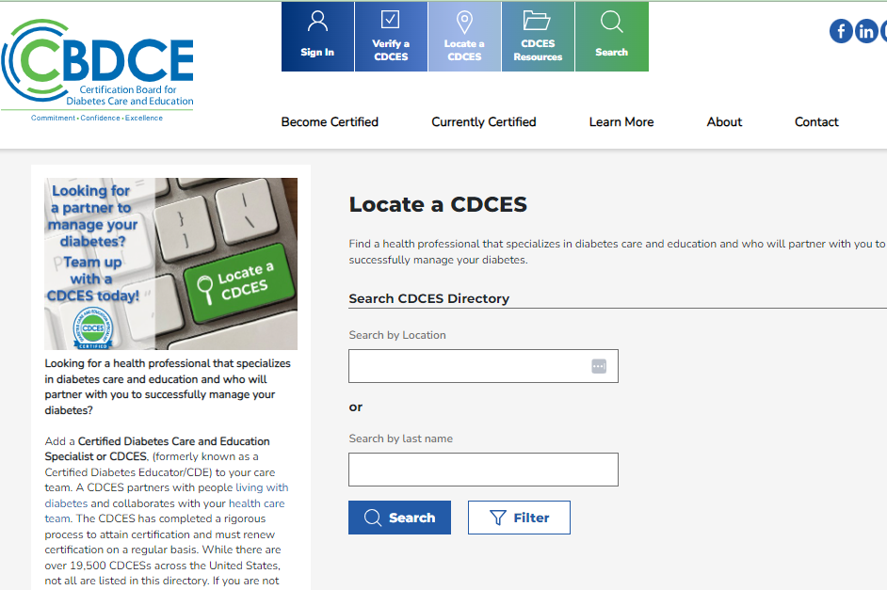
You’re a CDCES – now what?
Keep doing all the great things you’ve been doing
Look for opportunities to share that you’ve earned the certification
Add your contact information in the ‘Locate a CDCES’ area of the portal

Slide 21
You’re a CDCES – now what?
Look for opportunities to strengthen your knowledge and professional network, e.g., join the Association of Diabetes Care and Education and/or American Diabetes Association
Understand parameters of the certification – certification doesn’t change your scope of practice or what you can do in your role. Learn more here.

Slide 22
Maintaining the CDCES Credential
Five year renewal cycle
Various ways to renew, including practice and accrual of continuing education
For first time renewals, accrual begins on January 1 of the year following their initial certification, e.g., became a CDCES any day in 2023, accrual started Jan 1, 2024; became a CDCES on any day in 2024, accrual starts Jan 1, 2025.
Learn more by visiting the CBDCE website at cbdce.org

Slide 23
Today’s Presenter:
Name & Credentials, CDCES®
Contact Information: xx@gmail.com
Don’t forget to provide feedback on the presentation today -
scan for access to the presentation survey
Notes:
Your feedback is important to me and CBDCE – please complete the survey to let me know your thoughts about the presentation!

Slide 24
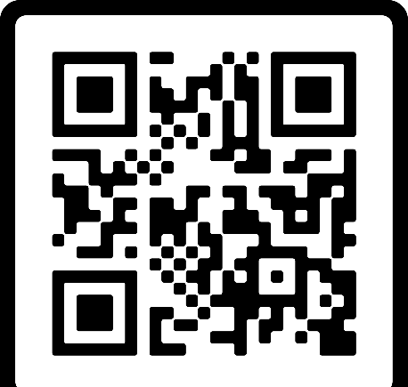
www.cbdce.org
info@cbdce.org
Phone: 847.228.9795
Certification Board for Diabetes Care and Education
Schaumburg, IL
Contact Us Form

Slide 25
Why I Became a CDCES…
“It is crucial to have a CDCES as a team member in the hospital, as well as, outpatient setting…Not only does the CDCES educate, they also encourage and collaborate on how to manage and improve care. CDCESs are a vital part of the diabetes management team and have the time to spend with patients that physicians do not always have to help achieve the best outcomes.”
Rebecca Morrison, BSN, RN, CDCES Marietta, GA
Notes:
These are extra slides that you can use to support your reasons to become a CDCES. Use as you wish.

Slide 26
Why I Became a CDCES…
“Every CDCES that I have met at local and national meetings are so excited to share their ideas; it is like one big family who really cares about treating people with diabetes and helping each other to do better in our careers. How can someone not be excited to join such a group!”
Julie Stading, PharmD, CDCES Creighton University, Eagle, NE

Slide 27
Why I Became a CDCES…
“The most rewarding part of being a CDCES is helping people with diabetes overcome barriers and improve their health. My decision to becoming certified was the best career move I have taken as a Registered Dietitian!” Debra D'Angelo, RDN, CDCES Dietitian/Diabetes Educator, Regal Medical Group, Camarillo, CA

